Slide 1
Generating Random Numbers
By Dr. Jason Merrick
Notes:
Last update August 20, 1998

Slide 2
What We’ll Do ...
Random-number generation
Generating random variates
Non-stationary Poisson processes
Variance reduction

Slide 3
Random-Number Generators (RNGs)
Algorithm to generate independent, identically distributed draws from the continuous UNIF (0, 1) distribution
  These are called random numbers in simulation
Basis for generating observations from all other distributions and random processes
  Transform random numbers in a way that depends on the desired distribution or process (later in this chapter)
It’s essential to have a good RNG
There are a lot of bad RNGs — this is very tricky
  Methods, coding are both tricky
f(x)
1
0
1
x

Slide 4
Pseudo Random Numbers
Random numbers generated by a computer are not really random
They just behave like random numbers
For a large enough sample, the generated values will pass all tests for a uniform distribution
  If you look at a histogram of a large number, it will look uniform
  Pass chi-square test
  Pass Kolmogorov-Smirnov Test
The stream of random numbers will pass all the tests for randomness
  Runs test
  Autocorrelation test

Slide 5
Linear Congruential Generators (LCGs)
The most common of several different methods
Generate a sequence of integers Z₁, Z₂, Z₃, … via the recursion
Z_{i} = (a Z_{i–1} + c) (mod m)
a, c, and m are carefully chosen constants
Specify a seed, Z₀ to start off
“mod m” means take the remainder of dividing by m as the next Z_{i}
All the Z_{i}’s are between 0 and m – 1
Return the ith “random number” as U_{i} = Z_{i} / m

Slide 6
Example of a “Toy” LCG
Parameters m = 63, a = 22, c = 4, Z₀ = 19:
Z_{i} = (22 Z_{i–1} + 4) (mod 63), seed with Z₀ = 19
  i 22 Z_{i–1}+4 Z_{i} U_{i}
  0 19
  1 422 44 0.6984
  2 972 27 0.4286
  3 598 31 0.4921
  4 686 56 0.8889
  : : : :
  61 158 32 0.5079
  62 708 15 0.2381
  63 334 19 0.3016
  64 422 44 0.6984
  65 972 27 0.4286
  66 598 31 0.4921
  : : : :
Cycling — will repeat forever
Cycle length ≤ m
(could be < m depending
on parameters)
Pick m BIG

Slide 7
Issues with LCGs
Cycle length
  Typically, m = 2.1 billion (= 2³¹ – 1) or more
  Other parameters chosen so that cycle length = m or m – 1
Statistical properties
  Uniformity, independence
  There are many tests of RNGs
    Empirical tests
    Theoretical tests — “lattice” structure (next slide …)
Speed, storage — both are usually fine
Must be carefully, cleverly coded — BIG integers
Reproducibility — streams (long internal subsequences) with fixed seeds

Slide 8
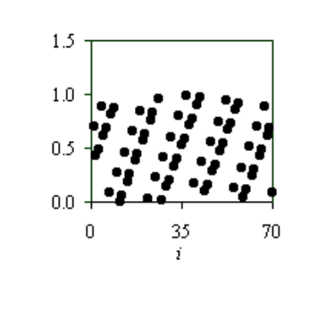
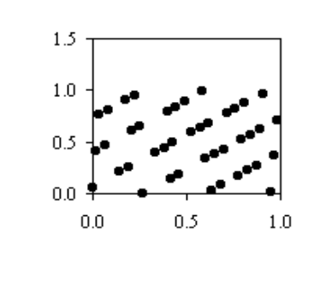
Issues with LCGs (cont’d.)
“Regularity” of LCGs (and other kinds of RNGs): For the earlier “toy” LCG …
“Design” RNGs: dense lattice in high dimensions
Other kinds of RNGs — longer memory in recursion, combination of several RNGs
Plot of U_{i} vs. i
Plot of U_{i} vs. U_{i-1}
“Random Numbers Fall Mainly in the Planes”
— Marsaglia

Slide 9
The Arena RNG
LCG with: m = 2³¹ – 1 = 2,147,483,647
a = 7⁵ = 16,807
c = 0
Cycle length = m – 1
Ten different automatic streams with fixed seeds
  Default stream number is 10
  Can access other streams after distributional parameters, e.g., EXPO (6.7, 4) for stream 4
  Good idea to use separate streams for separate purposes
SEEDS module (Elements panel) to get > the 10 automatic streams, specify seeds, name streams
A well-tested generator in an efficient code.

Slide 10
Generating Random Variates
Have: Desired input distribution for model (fitted or specified in some way), and RNG (UNIF (0, 1))
Want: Transform UNIF (0, 1) random numbers into “draws” from the desired input distribution
Method: Mathematical transformations of random numbers to “deform” them to the desired distribution
  Specific transform depends on desired distribution
  Details in online Help about methods for all distributions
Do discrete, continuous distributions separately

Slide 11
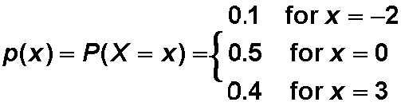
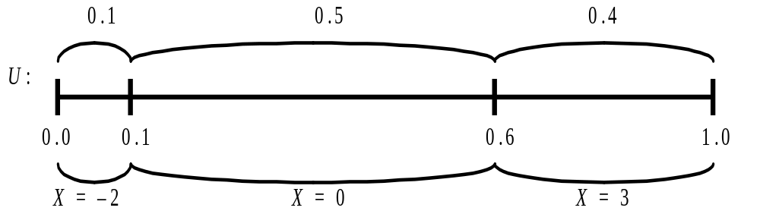
Generating from Discrete Distributions
Example: probability mass function
Divide [0, 1] into subintervals of length 0.1, 0.5, 0.4; generate U ~ UNIF (0, 1); see which subinterval it’s in; return X = corresponding value
–2
0
3

Slide 12
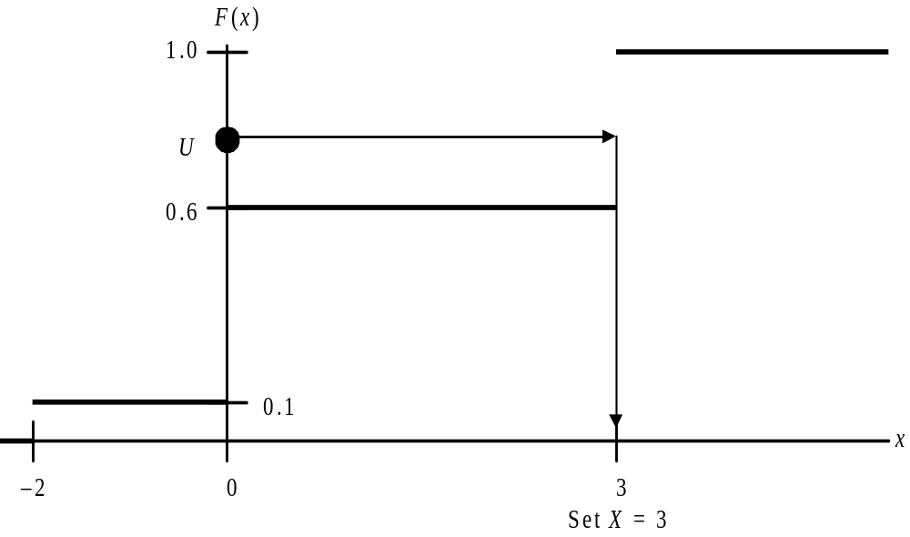
Discrete Generation: Another View
Plot cumulative distribution function; generate U and plot on vertical axis; read “across and down”
Inverting the CDF
Equivalent to earlier method

Slide 13
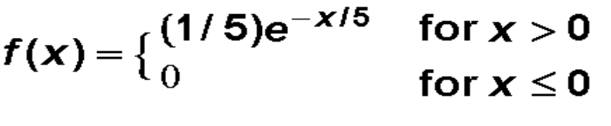
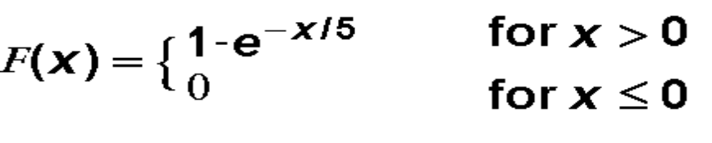
Generating from Continuous Distributions
Example: EXPO (5) distribution
Density (PDF)
Distribution (CDF)
General algorithm (can be rigorously justified):
1. Generate a random number U ~ UNIF(0, 1)
2. Set U = F(X) and solve for X = F^{–1}(U)
  Solving for X may or may not be simple
  Sometimes use numerical approximation to “solve”

Slide 14
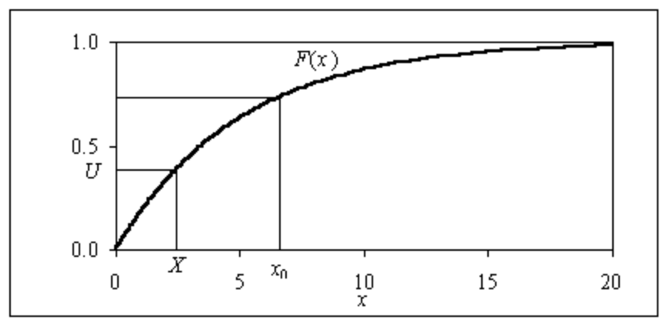
Generating from Continuous Distributions (cont’d.)
Solution for EXPO (5) case:
Set U = F(X) = 1 – e–X/5
e–X/5 = 1 – U
–X/5 = ln (1 – U)
X = – 5 ln (1 – U)
Picture (inverting the CDF, as in discrete case):
Intuition:
More U’s will hit F(x) where it’s steep
This is where the density f(x) is tallest, and we want a denser distribution of X’s

Slide 15
Non-stationary Poisson Processes
Many systems have externally originating events affecting them — e.g., arrivals of customers
If process is stationary over time, usually specify a fixed inter-event-time distribution
But process could vary markedly in its rate
  Fast-food lunch rush
  Freeway rush hours
Ignoring nonstationarity can lead to serious model and output errors
Already seen this — call-center arrivals, Chap. 8

Slide 16
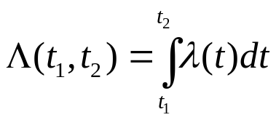
Non-stationary Poisson Processes (cont’d.)
Usual model: nonstationary Poisson process:
  Have a rate function l(t)
  Number of events in [t1, t2] ~ Poisson with mean
Issues:
  How to estimate rate function?
  Given an estimate, how to generate during simulation?
λ(t)
t

Slide 17

Nonstationary Poisson Processes (cont’d.)
Estimation of the rate function
  Probably the most practical method is piecewise constant
    Decide on a time interval within which rate is fixed
    Estimate from data the (constant) rate during each interval
    Be careful to get the units right: arrivals per time unit being used throughout the model, which may not be the time interval for the estimate rate function
  Other methods exist in the literature
t

Slide 18

Non-stationary Poisson Processes (cont’d.)
Generating — thinning method
  Find max l* of the estimated rate function
  Generate “candidate” arrivals at max rate (Interarrivals ~ EXPO(1 / l*))
  “Accept” a candidate arrival at time t with probability
Arena logic for this in Model 8.1 (call center)
Alternate method: invert a unit-rate stationary Poisson process against cumulative rate function
t

Slide 19
Rejection Sampling
For the non-homogeneous Poisson process
  we sampled from a process with the maximum rate
  then we rejected enough to thin the process down to the correct rate
This is an example of rejection sampling
Rejection sampling can also be used for sampling from univariate distributions where F⁻¹(x) does not exist or cannot be easily approximate
Basic Idea
  Sample from another distribution that is easy to sample from
  Reject those that are drawn from area where the target distribution has low density

Slide 20

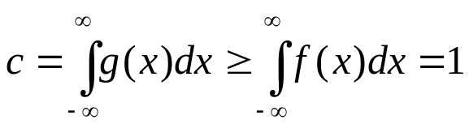
Rejection Sampling
Thus
  g(x) is not a probability density function
  But g(x)/c is a probability density function
  Must choose g(x) so that sampling from g(x)/c is easy
Want to sample from this distribution
f(x)
This function dominates f(x)
g(x)

Slide 21
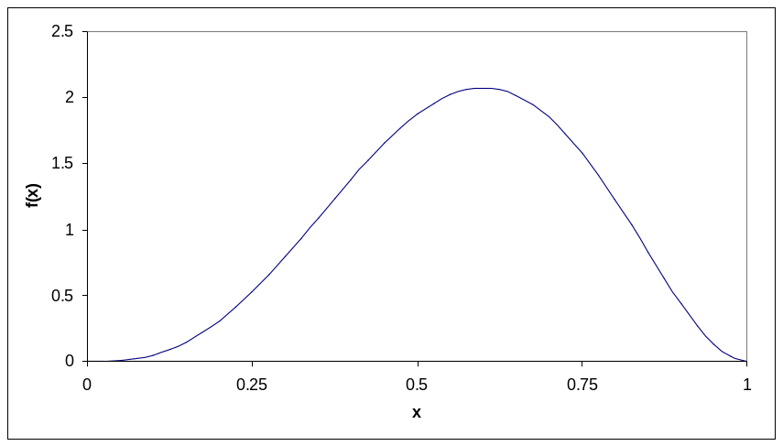

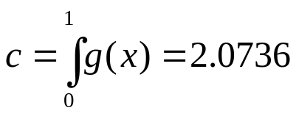

Rejection Sampling
Suppose we wish to sample from a beta(4,3) distribution
This distribution has its mode at x=0.6 with f(0.6)=2.0736
So

Slide 22
Rejection Sampling
We end up with the following algorithm for sampling from a beta(4,3) distribution
  Generate Y from a Uniform distribution on [0,1]
  Calculate f(Y)/g(Y) = 60*Y³*(1-Y)²/2.0736
  Generate U from a Uniform distribution on [0,1]
  Reject Y and go back to the start if U > f(Y)/g(Y)
  Otherwise Y is your sample
Example
  Suppose we draw Y = 0.25
  Then f(Y)/g(Y) = 60*0.25³*0.75²/2.0736 = 0.254313
  So if our U turns out to be less than 0.254313 then 0.25 is our sample
  If our U turns out to be more than 0.254313 then we must start again

Slide 23
Variance Reduction
Random input ⇒ random output (RIRO)
In other words, output has variance
  Higher output variance means less precise results
  Would like to eliminate or reduce output variance
    One (bad) way to eliminate: replace all input random variables by constants (like their mean)
    Will get rid of random output, but will also invalidate model
    Thus, best hope is to reduce output variance
Easy (brute-force) variance reduction: just simulate some more
  Terminating: additional replications
  Steady-state: additional replications or a single, longer run

Slide 24
Variance Reduction (cont’d.)
But sometimes can reduce variance without more runs — free lunch (?)
Key: unlike physical experiments, can control randomness in computer-simulation experiments via manipulating the RNG
  Re-use the same “random” numbers either as they were, in some opposite sense, or for a similar but simpler model
Several different variance-reduction techniques
  Classified into categories — common random numbers, antithetic variates, …
  Usually requires thorough understanding of model, “code”
  Will look only at common random numbers in detail

Slide 25
Common Random Numbers (CRN)
Applies when objective is to compare two (or more) alternative configurations or models
  Interest is in difference(s) of performance measure(s) across alternatives
  In the PWS, we wanted to test many different configurations of the oil transportation system
Intuition: get sharper comparison if you subject all alternatives to the same “conditions”
  Then observed differences are due to model differences rather than random differences in the “conditions”
  For this PWS this means try out each system configuration with the same simulated traffic arrivals and the same simulated weather patterns

Slide 26
Synchronization of Random Numbers in CRN (cont’d.)
Synchronize by source of randomness (we’ll do)
  Assign a stream to each point of variate generation — separate random-number “faucets”
    Interarrivals, Part types, Processing times, etc.
  Fairly simple but might not ensure complete synchronization
    Something might cause parts to arrive to a Server in a different order across alternatives
  Still usually get some benefit from this
In PWS Simulation
  One file of traffic arrivals
  One file of weather variables
  Each alternative system design was tested on the same traffic and weather patterns

Slide 27
CRN Synchronization by Source (cont’d.)
SEEDS module (Elements panel)
  Give names to the streams
  Common Initialize Option: space seeds within a stream 100,000 apart between replications to avoid (?) overlap
Use stream assignments (by name) in Arrive, Expressions, and Sequences modules
  Append stream name after parameter-value arguments
    Expo(12, STREAM1)

Slide 28
CRN Synchronization by Source (cont’d.)
We will compare a run using common random numbers to a run with independent random numbers
Using SEEDS to force independence across alternatives
  Earlier comparison: used default stream (10) for both alternatives A and B but in haphazard unsynchronized way
  So results were not independent, but probably not “like vs. like” correlated either, as we’d like for synchronized CRN
  To get independence, modify SEEDS module for alternative B to skip streams 1–15 before naming streams: Model 11.2
    Can remove place holder for Stream 10: already skipped

Slide 29
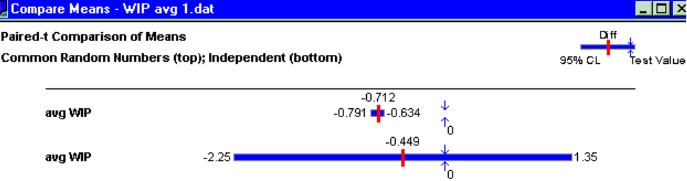
Effect of CRN
Made 20 replications of A and B
  First run: Independent sampling, as just discussed
  Second run: Synchronized CRN
  Output Analyzer, Analyze/Compare Means for 95% c.i. on difference between expected average WIPs (with Paired-t)

Slide 30
CRN Statistical Issues
In Output Analyzer, Analyze/Compare Means option, have choice of Paired-t or Two-Sample-t for c.i. test on difference between means
  Paired-t subtracts results replication by replication — must use this if doing CRN
  Two-Sample-t treats the samples independently — can use this if doing independent sampling, often better than Paired-t
Mathematical justification for CRN
  Let X = output r.v. from alternative A, Y = output from B
  Var(X – Y) = Var(X) + Var(Y) – 2 Cov(X, Y)
= 0 if indep
> 0 with CRN

Slide 31
Other Variance-Reduction Techniques
For single-system simulation, not comparisons
Antithetic variates: make pairs of runs
  Use “U’s” on first run of pair, “1 – U’s” on second run of pair
  Take average of two runs: negatively correlated, reducing variance of average
  Like CRN, must take care to synchronize
Var(X + Y) = Var(X) + Var(Y) + 2 Cov(X, Y)

